Slide 1
Law making process:
Path of a BILL to LAW
Key Stage 3 & 4

Slide 2


Check your knowledge…
What is LAW? Why do we need Laws?
Who makes the Law?
BILL vs. LAW – what’s the difference?

Slide 3
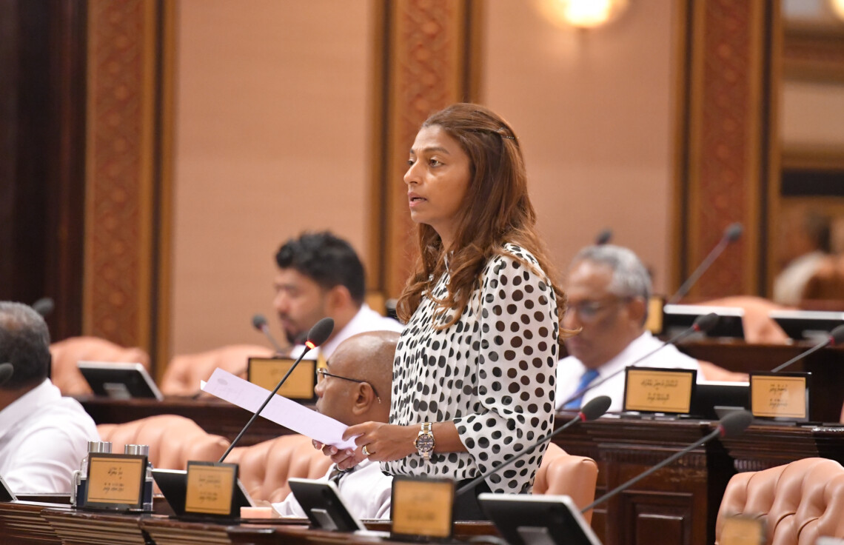


Stage 1:
DRAFTING & INTRODUCTION
Who can propose a Bill to Majlis?
  the government
  MPs
*MP who introduces the Bill = Sponsor of the Bill.
Stage 1
Stage 2
Stage 3
Stage 4
Stage 5
Stage 6

Slide 4
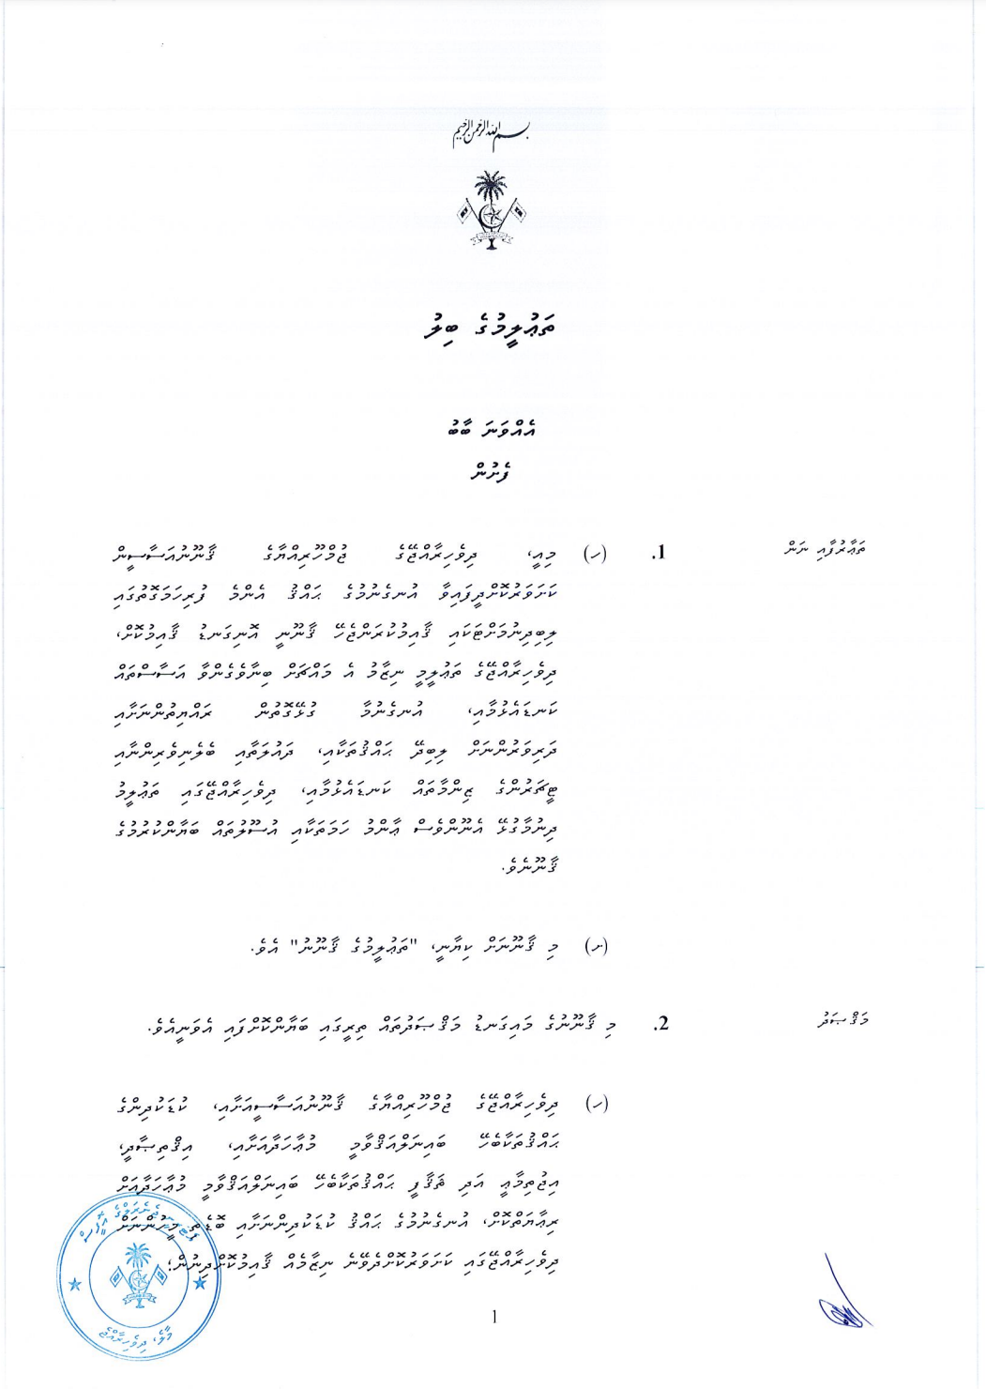
What does a BILL include?
      a title
      sections or clauses numbered accordingly
      side headings for each section
      an enactment date
      definitions of any important terminology used

Slide 5
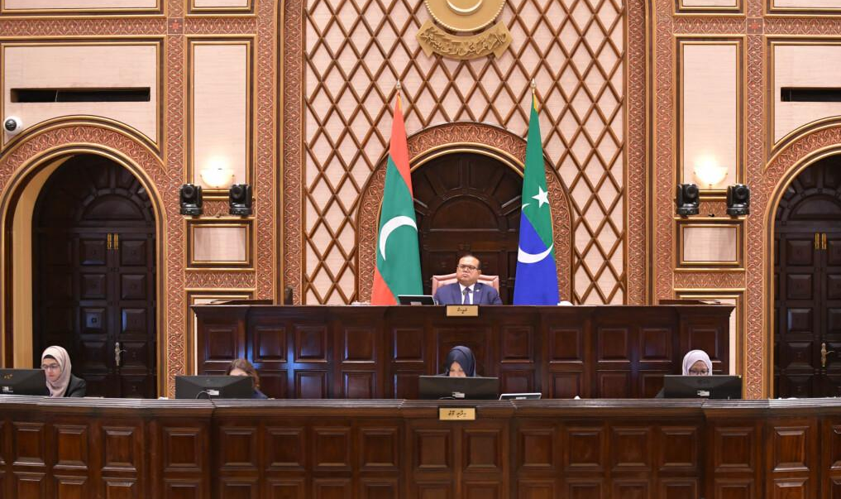
Stage 2:
First Reading
Only the title of the Bill is read out.
By Who? Speaker of the Majlis
Stage 1
Stage 2
Stage 3
Stage 4
Stage 5
Stage 6

Slide 6
Stage 3:
Second Reading
Consist of 2 parts:
    1. PRELIMINARY DEBATE STAGE
    2. COMMITTEE REVIEW STAGE
    3. PRESENTATION OF COMMITTEE REPORT TO MAJLIS FLOOR
Stage 1
Stage 2
Stage 3
Stage 4
Stage 5
Stage 6

Slide 7
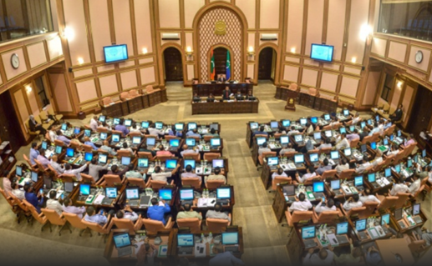
Stage 3:
Second Reading
1. PRELIMINARY DEBATE STAGE:
MPs debate on the general principles and themes
no amendments are proposed
At the end, a vote is cast to accept or reject the Bill
Speaker determines the relevant committee
Stage 1
Stage 2
Stage 3
Stage 4
Stage 5
Stage 6

Slide 8
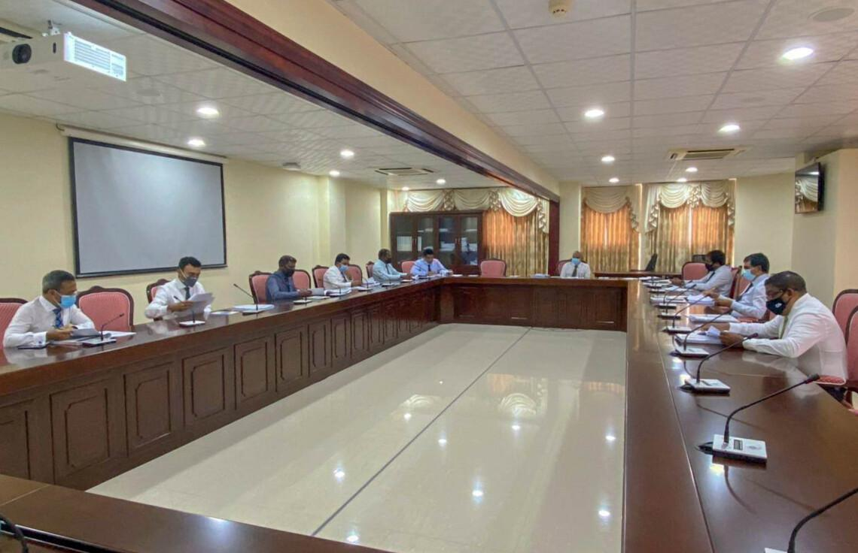
Stage 3:
Second Reading
2. COMMITTEE REVIEW STAGE:
  Committee examines the bill, gather input from experts and stakeholders, and propose amendments.
  A Committee Report is presented to Majlis for debate
Stage 1
Stage 2
Stage 3
Stage 4
Stage 5
Stage 6

Slide 9
Stage 3:
Second Reading
3. PRESENTATION OF COMMITTEE REPORT
TO MAJLIS FLOOR
Stage 1
Stage 2
Stage 3
Stage 4
Stage 5
Stage 6

Slide 10
What is a
Parliamentary Committee
Committees of Majlis are of 2 types:
    1. Select Committees – temporary, formed for specific tasks
    2. Standing Committees - permanent bodies with ongoing responsibilities - further divided into 2 types:
a) Committees related to Majlis
b) Committees related to Institutions

Slide 11
Standing Committees
COMMITTEES RELATED TO INSTITUTIONS
16 Committees to scrutinize all state institutions
Committee on Secondary Legislation
Public Accounts Committee
Committee on Economic Affairs
Committee on Social Affairs
Committee on National Security Services
Committee on Independent Institutions
Committee on National Development and Heritage
Committee on Foreign Relations
Committee on State Owned Enterprises
Committee on Decentralization
Judiciary Committee
Committee on Environment and Climate Change
Committee on Human Rights and Gender
Government Oversight Committee
Committee on Information and Communication Technology
Housing Committee
COMMITTEES RELATED TO MAJLIS
reviews issues related to Majlis and Secretariat; do not review bills:
General Purpose Committee
Petitions Committee
Committee on Member’s Privileges and Ethics

Slide 12
Stage 4:
Third Reading
After debate, the title of the Bill is read aloud to vote.
MPs given opportunity to present proposed amendments to the Bill.
Then it is VOTED whether to:
    accept or
    send it back to Committee for review or
    cancel
Stage 1
Stage 2
Stage 3
Stage 4
Stage 5
Stage 6

Slide 13

Stage 5:
Presidential Assent
Bill becomes a Law when ratified by President
Majlis must send the Bill for ratification within 7 days
Within 15 days, President must:
    Ratify it into law, Or
    Propose amendments and return it to Majlis.
Stage 1
Stage 2
Stage 3
Stage 4
Stage 5
Stage 6

Slide 14
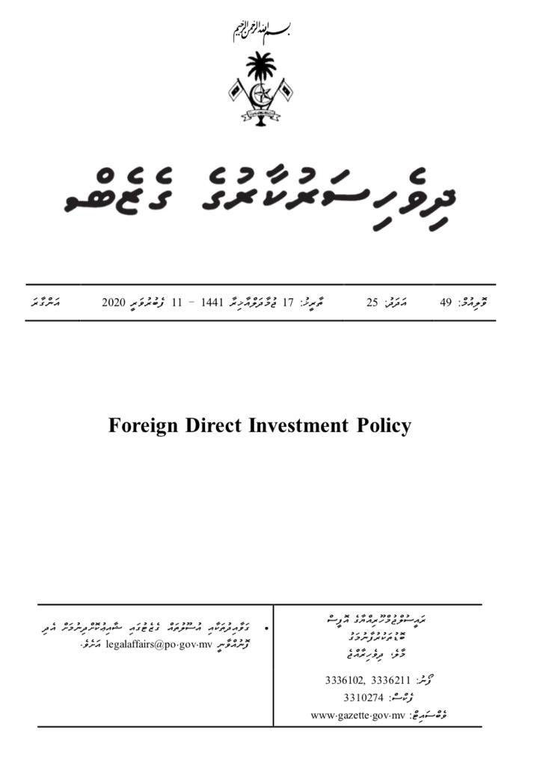
Stage 6:
Publication and Enforcement
Once ratified by President, bill becomes law.
Published in Gazette and enforceable on a specified date.
Stage 1
Stage 2
Stage 3
Stage 4
Stage 5
Stage 6

Slide 15
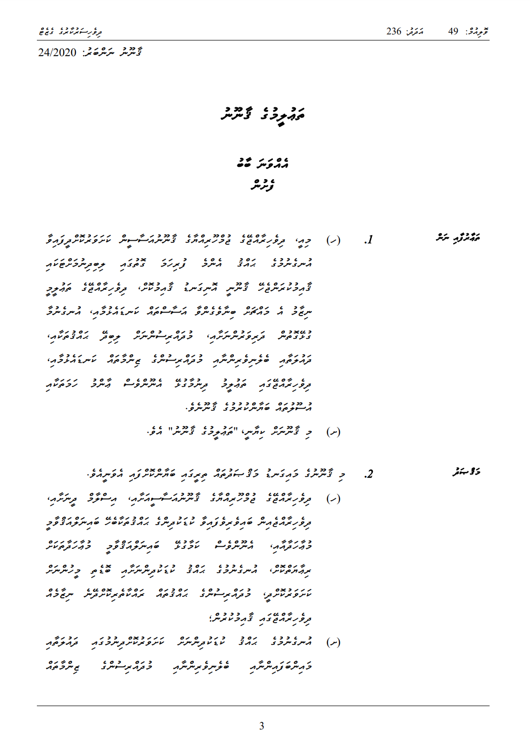
BILL becomes LAW

Slide 16

How can Citizens participate in the Law-making process?
QUESTION

